Slide 1
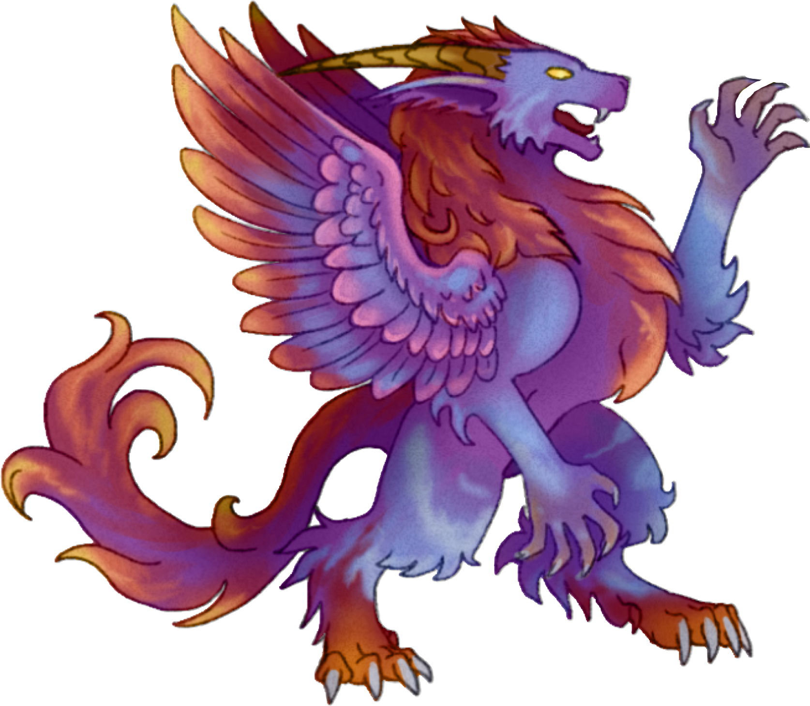
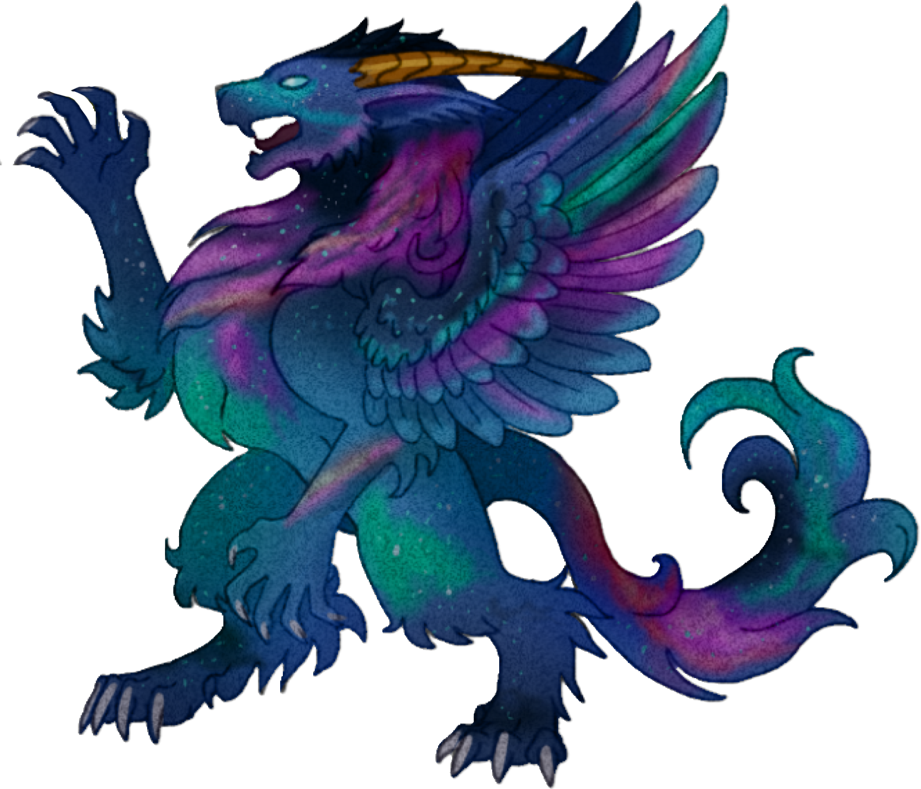
Elora King
elora.l.king@gmail.com
337-522-0724

Slide 2
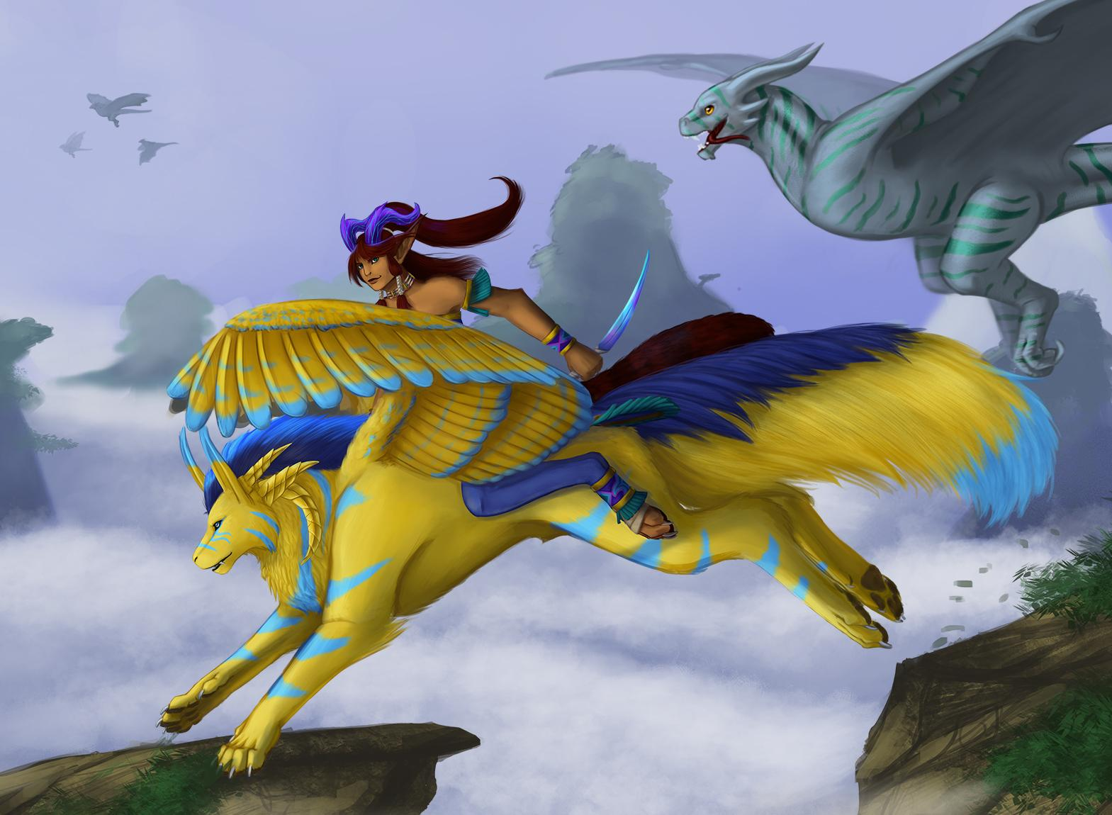
Game Plan
To introduce a unique tabletop RPG blending the flavors of Pokemon and Dungeons & Dragons within a high fantasy setting focusing on more storytelling mechanics
Less roll playing, more role playing

Slide 3
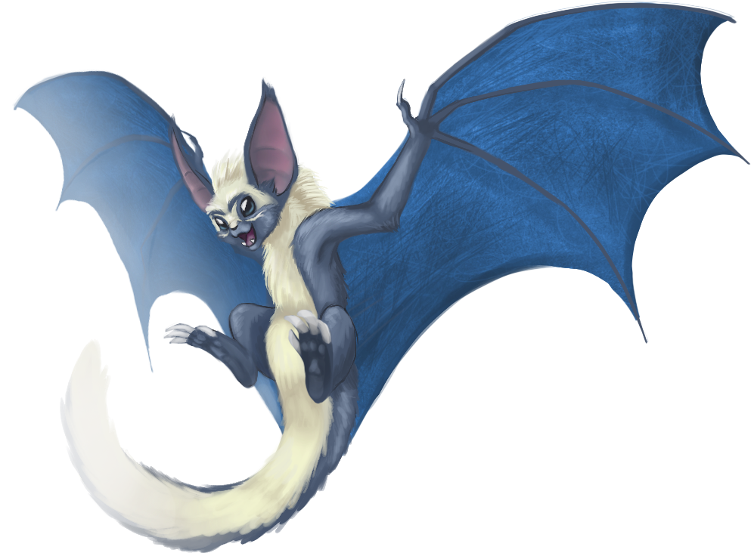
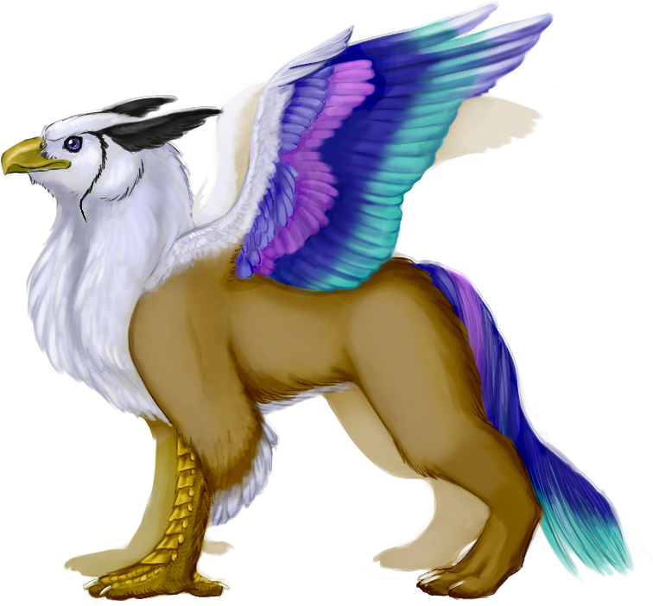
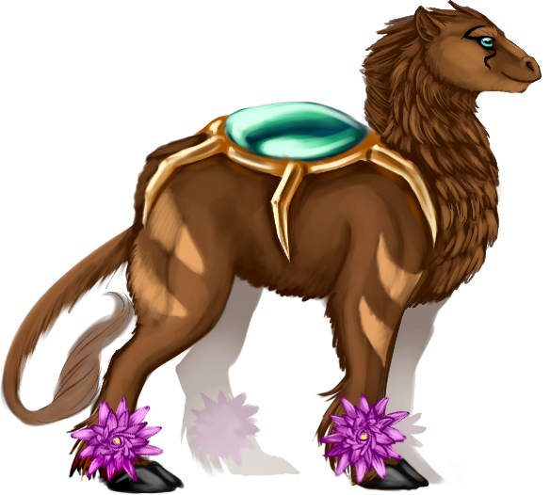
What is Kyrae?
Kyrae is a high fantasy, with minor sci-fi elements, setting born from “what ifs”
No Humans
Plethora of humanoids to choose from
Friendly Monsters
Taming mechanics
Adds complexity to the world(s)
Multiple Worlds
7 different worlds to explore

Slide 4
Who Am I?
Fancy Hat Studios
Art Lead, Comic Artist, Character Designer
Website design
Creator and co-lead designer for an unreleased tactics and gacha game project
Illustrator for an unreleased supplement book for Mystic Empyrean.
Personae Studios
Marketing Management and Lead UI Designer
Contractor
Outreach and Business Management
Writing and Editing

Slide 5
Opportunity
Tap into the ever growing tabletop market,
specifically the monster taming niche genre which is highly unexplored.
Only one direct competitor with limited mechanics.
Allowing for a more nuanced mechanics guide that can be adopted into other settings
A fully fleshed out setting that would be attractive to lovers of high fantasy and those who want something different that the current market doesn’t provide
Avoid the “Abused Gamer Syndrome” to allow more freedom in player enjoyment

Slide 6
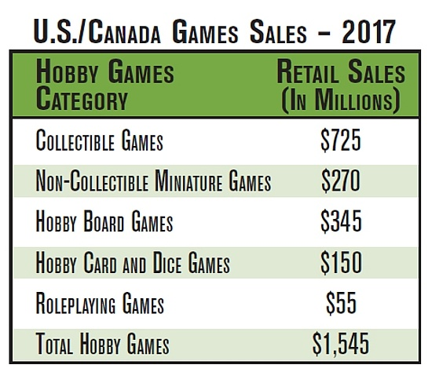
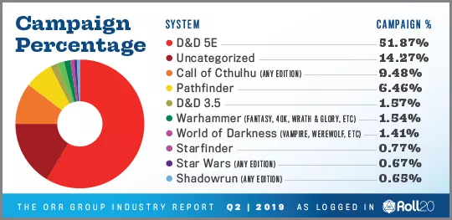
Market
“And Roleplaying Games, the smallest category, was up 22% from $45 million in 2016 to $55 million in 2017.”
-https://icv2.com/

Slide 7
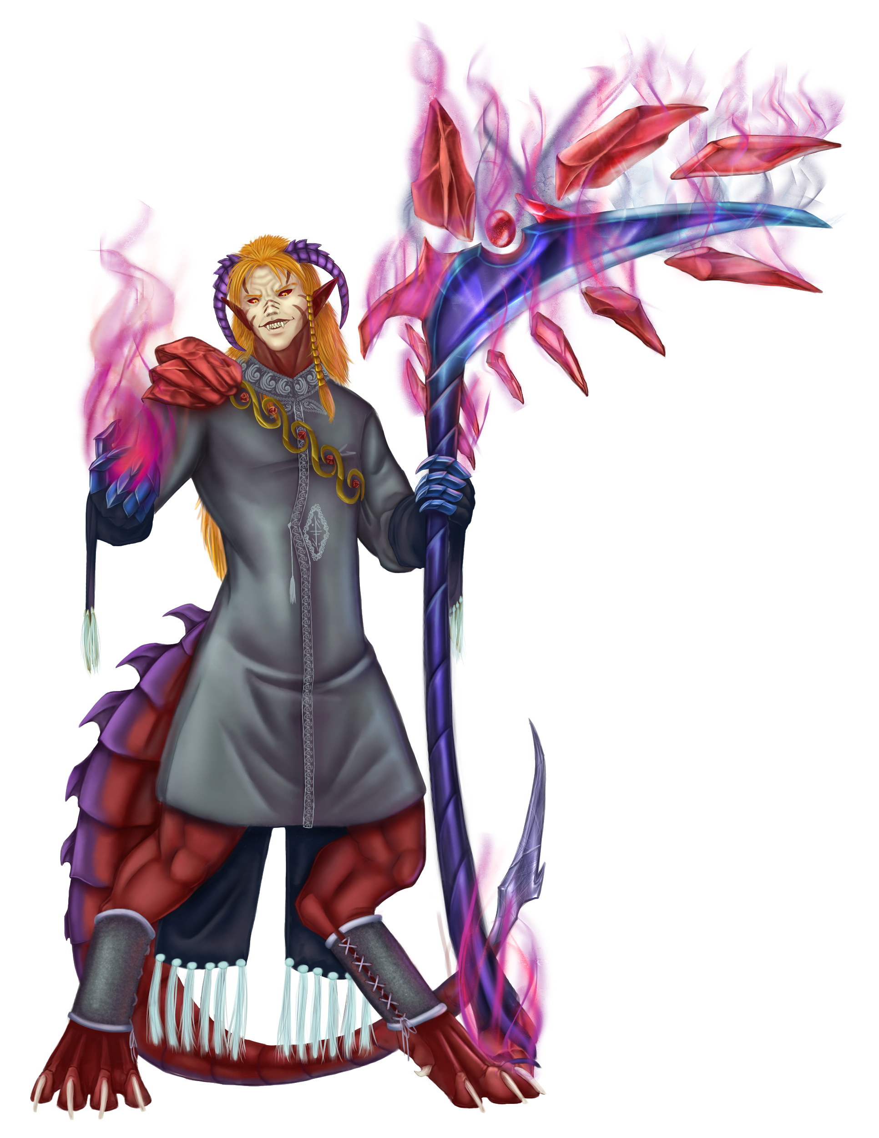
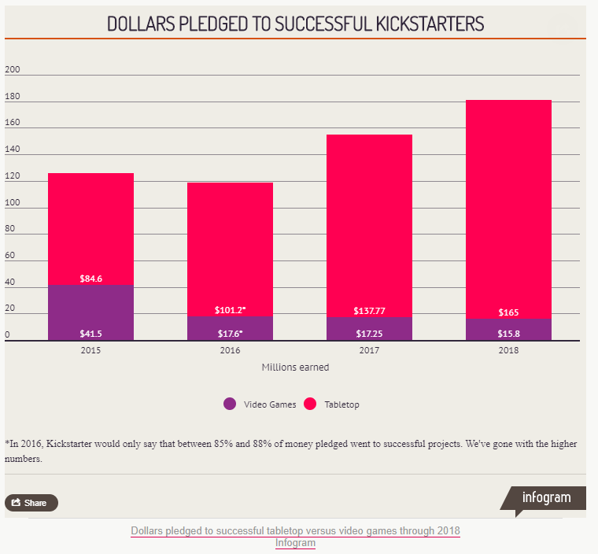
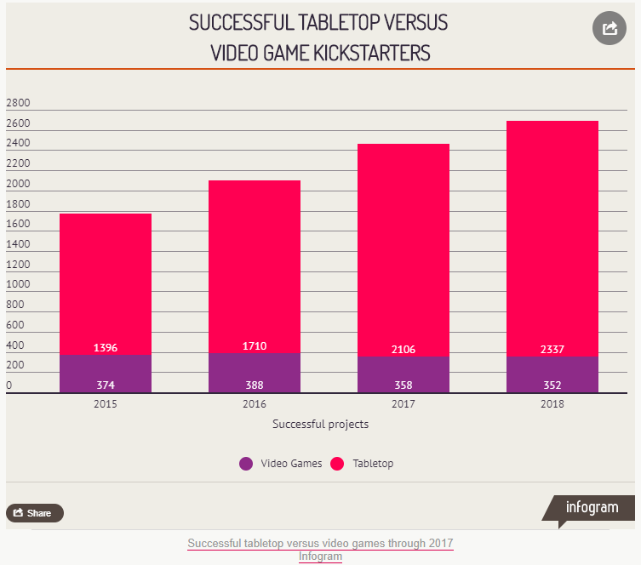
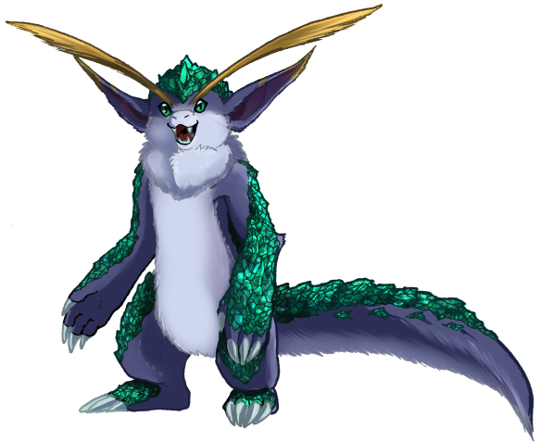
Competition

Slide 8
Strengths
Only one direct competitor: MajiMonsters
Only has mechanics for monster vs monster
Post Apocalyptic
Only 114 monsters
No monster raising mechanics
Kyrae offers:
Over 20+ different races, including subraces, to make each player character unique
Over 300+ monsters, not including combinations
7 explorable worlds rather than the traditional one
Allowing combat mechanics to include player vs npc, monster vs monster, monster vs npc, and player vs monster

